Slide 1

3 aspects of computer architecture not covered in this module
2025/4/30 Yushan Wang
1. Parallel Computing Architecture
2. Cache
3. Multi - Core Processor Architecture

Slide 2
Parallel Computing Architecture
What：
A parallel computing architecture refers to a computer system design that is intended to execute multiple computing tasks simultaneously. Parallel computing architectures can significantly reduce the time required to solve complex problems.
Where：
In the overall diagram of computer architecture, the parallel computing architecture is located in the continuum ranging from a single processor to a multi-processor system, and then to distributed and parallel computing systems.
Relationship：
In this module, the fundamental knowledge of computer architecture was learned, including Instruction Set Architecture (ISA), CPU design, and microarchitecture. These knowledge provide a foundation for understanding parallel computing architectures. For example:
  Instruction Set Architecture (ISA): Parallel computing may require an extended ISA to support multi-threading operations, which is related to the MIPS ISA and CPU design learned in this module.
  CPU design: Parallel computing architectures may involve the design of multi-core CPUs, which requires understanding how to integrate multiple processing units on a single chip and how to design efficient memory and data paths to support parallel operations.
  Microarchitecture: The implementation of parallel computing architectures usually involves microarchitecture optimization.

Slide 3
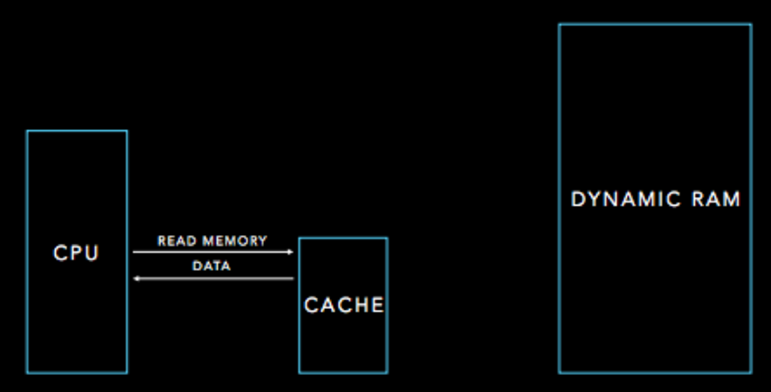
Cache
What:
Cache is a kind of high-speed storage component
Used to store data and instructions that the CPU is likely to frequently access in the near future.
Accelerate data access speed
Reduce the time
Where:
It is located in the storage hierarchy structure between the CPU and the main memory.
Relationship:
The course has covered the basic concepts of storage, such as memory addresses and data storage.
An extension of memory access optimization
Closely related to the data reading and writing operations in the MIPS programming we have studied.

Slide 4
Multi - Core Processor Architecture
What:
A multi - core processor integrates multiple processing cores on a single chip. Each core can execute instructions independently, and multiple cores can process different tasks or threads in parallel, thus enhancing the overall processing capacity and performance of the system.
Where:
It lies at the core level of a computer's processor, influencing the system's computing power and task - handling methods.
Relationship:
Based on the knowledge of single - core CPU design learned in the course, a multi - core processor is an extension and upgrade of it. It involves issues such as coordination, communication, and task allocation among multiple cores, and is closely related to the learned CPU design, instruction execution flow, etc. It increases the complexity of the system architecture and the potential for performance improvement.

Slide 5
Parallel Computing Architecture sub-topics:
Parallel Computing Model:
  It is an abstract framework for parallel computing systems, defining task decomposition, distribution, and processor collaboration methods.
Parallel Programming Model:
  It is an abstract model that assists programmers in developing parallel programs.
  OpenMP (based on shared memory, implemented through compiler directives for multi-threaded parallelism)
  MPI (used for distributed memory systems, through message-passing programming)
  CUDA (focusing on GPU parallel computing).
  It is based on the parallel computing model, adapted to different hardware architectures, and can leverage the performance advantages of the architectures.
Parallel Storage Architecture:
  Focuses on the storage and access of data in parallel computing environments.
  Distributed file systems (such as Ceph, which distributes data and provides high reliability and scalability)
  Shared storage systems (such as SAN, which provides shared storage for multi-processors)
  Storage mechanisms for GPUs (optimizing data transfer between video memory and main memory as well as cache management within GPUs).
  It is an important support for parallel computing architectures and can avoid storage becoming a performance bottleneck.

Slide 6
Parallel Computing Model
This is a planning concept, similar to the design drawings before building a house.
It stipulates how a parallel computing task should be split into smaller tasks and assigned to different "helpers" (processors), as well as how these "helpers" should cooperate together to complete the entire task.
The shared memory model, in this model, the "helpers" share a "storage room" (memory), which makes it convenient to get things, but there may be situations where they compete for the same thing simultaneously, and some special methods (locks, semaphores) need to be used to coordinate.
The distributed memory model is that each "helper" has its own "storage room", and they transfer things through "passing notes" (message passing).
The vector computing model is like a method specifically designed for processing long strings of data (vector data), where one instruction can process many data elements simultaneously.
This computing model has a significant impact on how the hardware is designed and how programmers write code.

Slide 7
Parallel Computing Model
Latest Industry Developments
Breakthrough in Optical Computing Parallel Models:
  With the development of large-scale AI models, the demand for computing power has skyrocketed. Optical computing has emerged as a new direction.
  The team from Tsinghua University has launched the "Taiji-I" intelligent optical computing chip, integrating multiple optical modalities and possessing high-throughput parallel computing capabilities, capable of completing general artificial intelligence tasks.
  The subsequent "Taiji-II" intelligent optical training chip has innovated the training architecture and significantly improved performance in large-scale learning and complex scene imaging domains.
Exploration of Parallel Computing Models Based on New Architectures:
  For quantum computing hardware, researchers have constructed quantum parallel computing models, leveraging the characteristics of quantum bits to achieve super-strong parallel computing.
  Although still in the early stages, it has shown great potential in cryptography, chemical simulation, and other fields.

